Slide 1
Doctor-Patient Conversation Summarizer
A web application that can record doctor and patient conversation and can generate summary or report on the basis of the conversation.

Slide 2
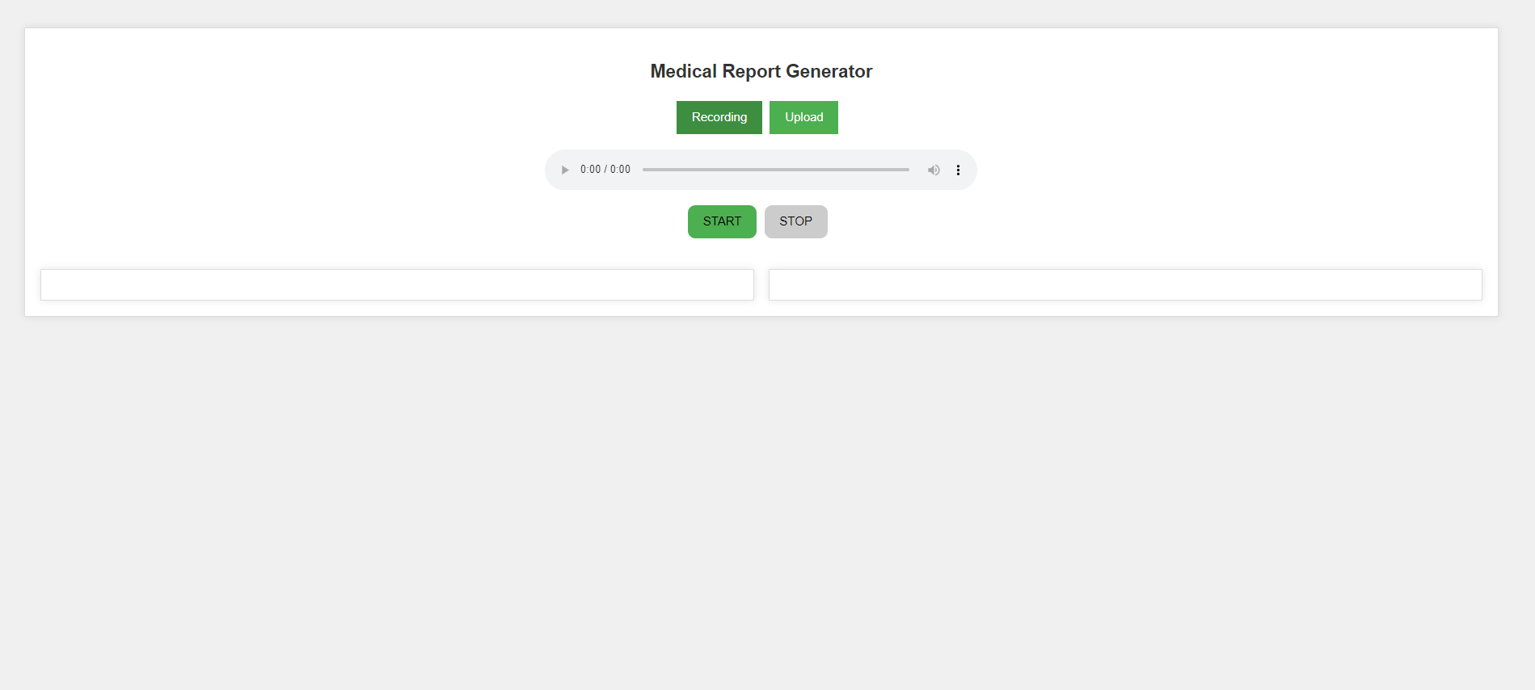
Web App [ Frontend ]
A reactjs based frontend where you can record audio or upload and audio file, the audio file will be uploaded and processed further in backend to summarize the conversation.

Slide 3
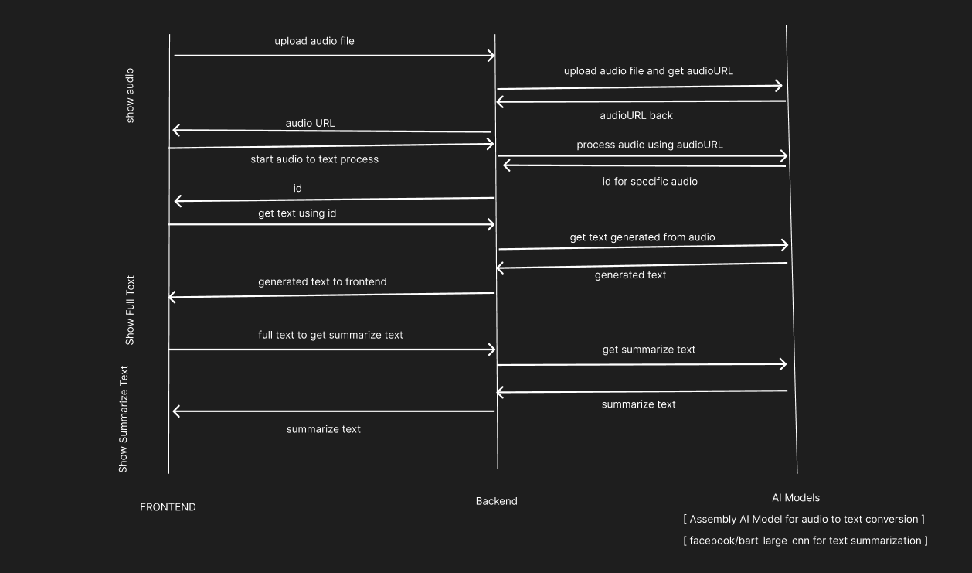
Architecture

Slide 4
Architecture
First Audio file is recorded or uploaded.
Then it is given to backend where backend upload it to assembly ai using api and get the audioURL.
Using this audio URL we make /uploadaudio call to assembly ai which process the audio and generates text from audio. It return id for the specific conversion.
Next we call /downloadaudio call in regular interval till the process is completed to get the converted text using the id.
Next we send this converted text to frontend where it is displayed.
Next frontend send this text to backend and backend calls summarization using the hugging face api which uses facebook/bert-large-cnn to summarize the text and returns the summarize text.
Next summarize text is responded back to frontend where summarize text is shown.

Slide 5
Backend
Server takes calls from frontend and further calls the AI models endpoint to start audio to text conversion, get the converted text, and finally summarize the text.
ASSEMBLY AI – assembly ai apis are used to convert audio to text
FACEBOOK/BERT-LARGE-CNN – using hugging face api this model is used to convert the full text into summarize text.

Slide 6
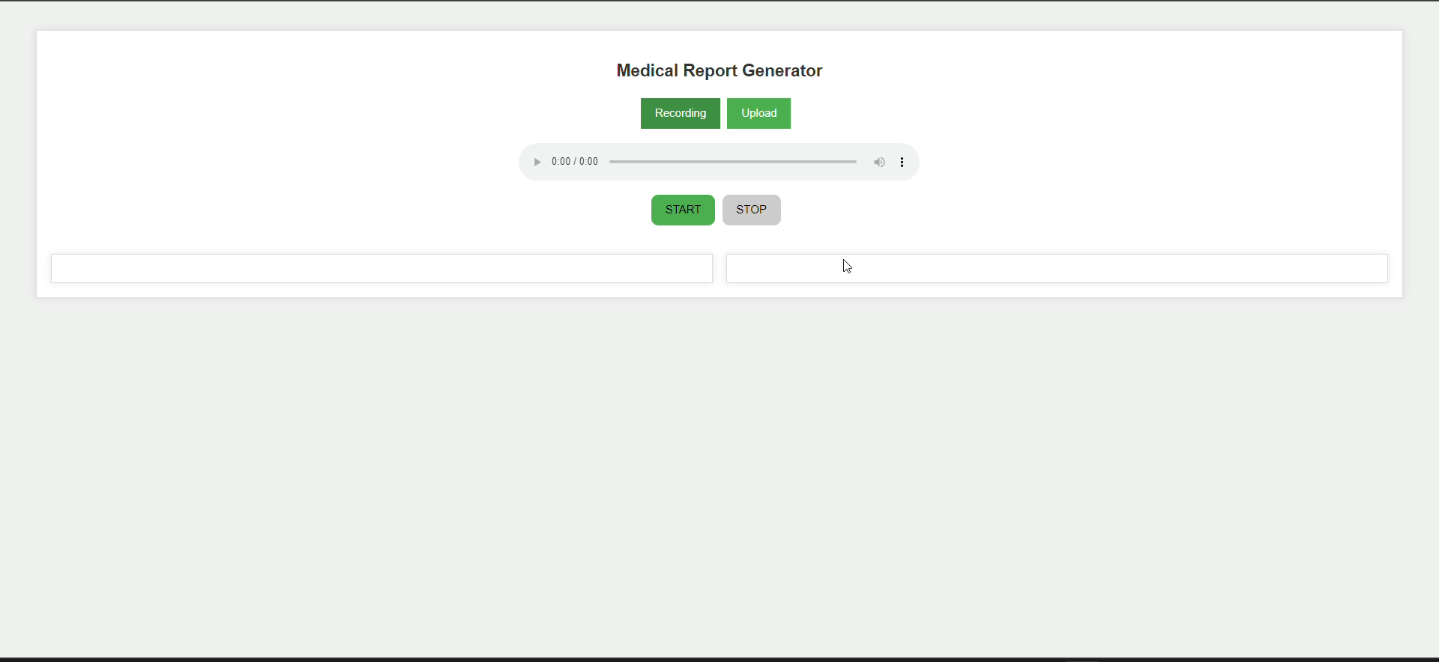
OUTPUT

